Slide 1


CamoPatch: An Evolutionary Strategy for Generating Camouflaged Adversarial Patches
CamoPatch: An Evolutionary Strategy for Generating Camouflaged Adversarial Patches
Squad 8

Slide 2

Table of contents
01
Overview of Adversarial Patch
02
Limitations of Existing Methods
03
CamoPatch: Proposed Method
04
Experiment
Squad 8

Slide 3
01
Overview of Adversarial Patch
What are Adversarial Attacks and Patches?
Why Are Adversarial Patches Dangerous?
Squad 8

Slide 4
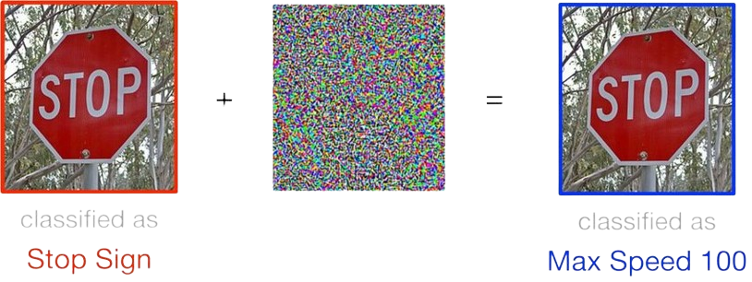
What are Adversarial Attacks and Patches?
Adversarial attacks are intentional changes of input data designed to fool machine learning models, especially deep neural networks (DNNs).
Squad 8

Slide 5
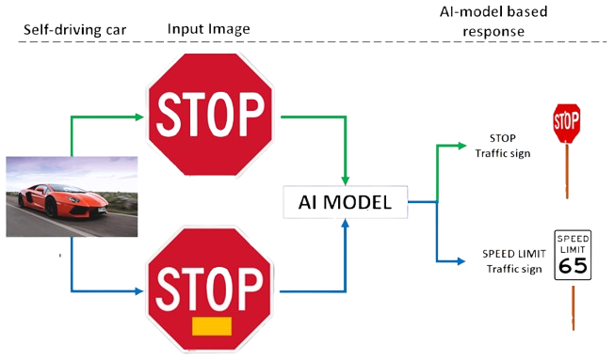
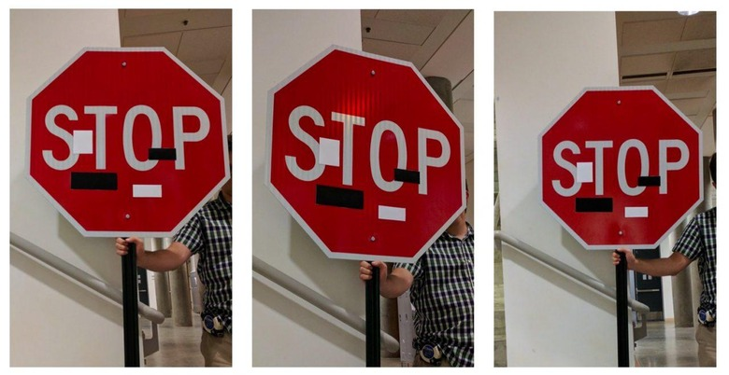
What are Adversarial Attacks and Patches?
One particularly practical and dangerous form of adversarial attack is the adversarial patch attack.
Adversarial patches focus on modifying just a small localized
Squad 8

Slide 6
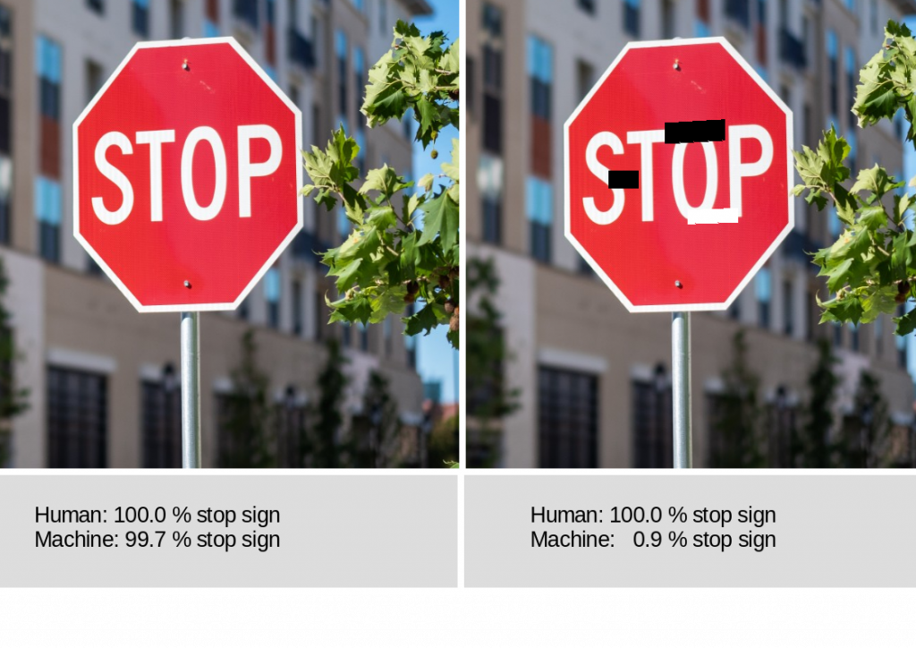
Why Are Adversarial Patches Dangerous?
Can be physically deployed in the real world and work even in black-box settings.
A single patch can fool the model across diverse inputs.
Squad 8

Slide 7
02
Limitations of Existing Methods
Visual Limitations of Existing Patches
Technical Limitations in Patch Optimization
Squad 8

Slide 8
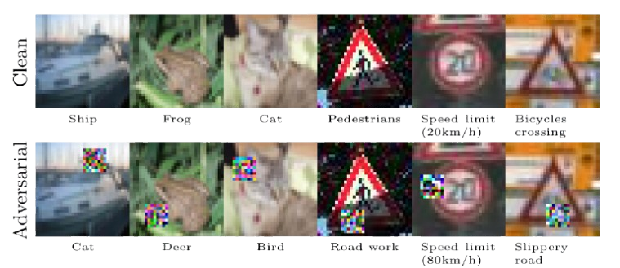
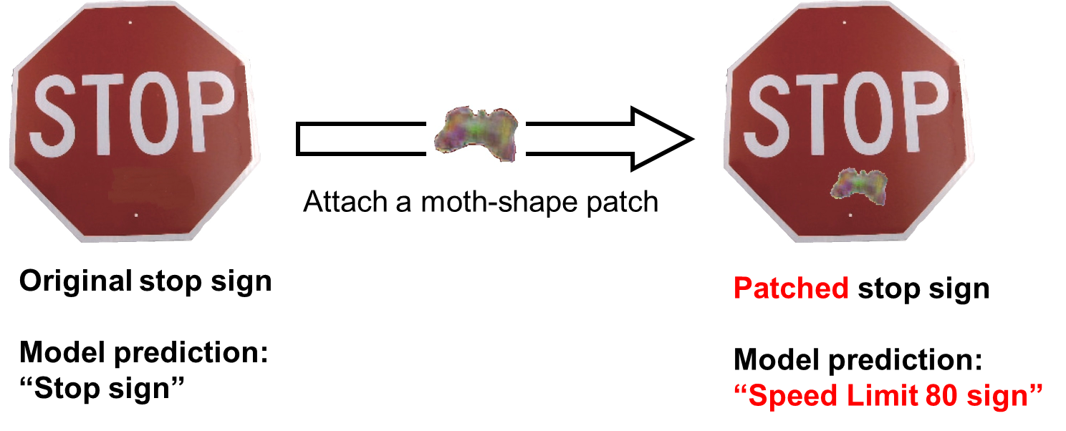
Visual Limitations of Existing Patches
Most adversarial patches have unnatural shapes and colors, making them easily noticeable to humans.
The lack of visual camouflage reduces real-world applicability and leads to unfair robustness evaluation.
Few existing methods focus on camouflaging the patch to blend naturally into the original image.
Squad 8

Slide 9
Technical Limitations in Patch Optimization
Gradient-based methods dominate existing research but are impractical in black-box settings. Meanwhile, black-box approaches often suffer from low query efficiency or weak optimization capabilities.
While some methods use evolutionary strategies, they typically optimize either the patch pattern or the location — rarely both, especially in constrained scenarios such as decision-only feedback.
Squad 8

Slide 10
03
CamoPatch: Proposed Method
Method Objective
Problem Formulation
Patch Initialization and Optimization
Location Optimization
Squad 8

Slide 11
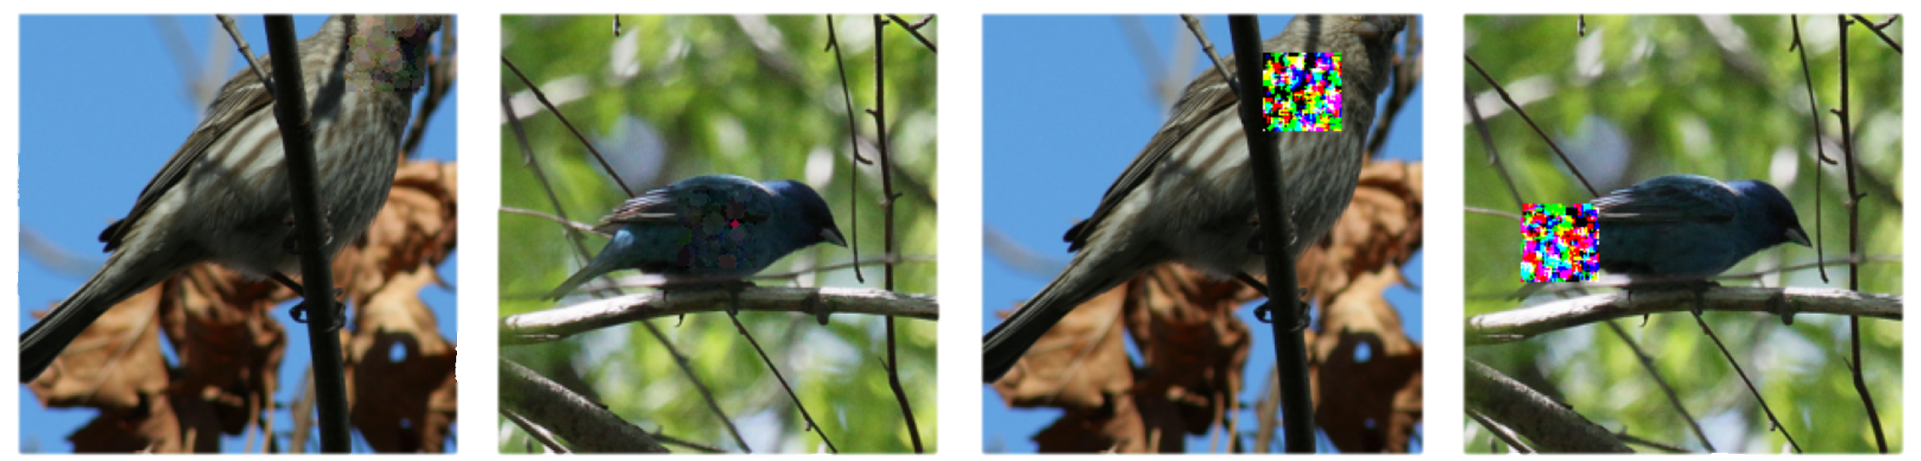
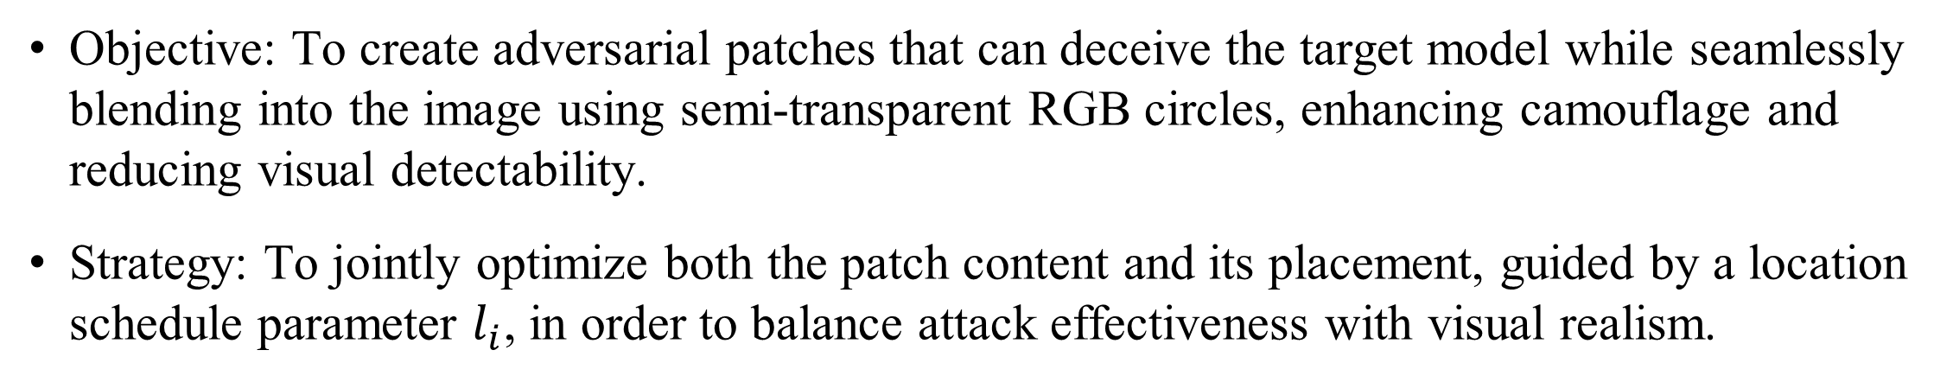
Method Overview
Objective: To create adversarial patches that can deceive the target model while seamlessly blending into the image using semi-transparent RGB circles, enhancing camouflage and reducing visual detectability.
Strategy: To jointly optimize both the patch content and its placement, guided by a location schedule parameter $l_{i}$, in order to balance attack effectiveness with visual realism.
Proposed method
Patch-RS
Squad 8

Slide 12
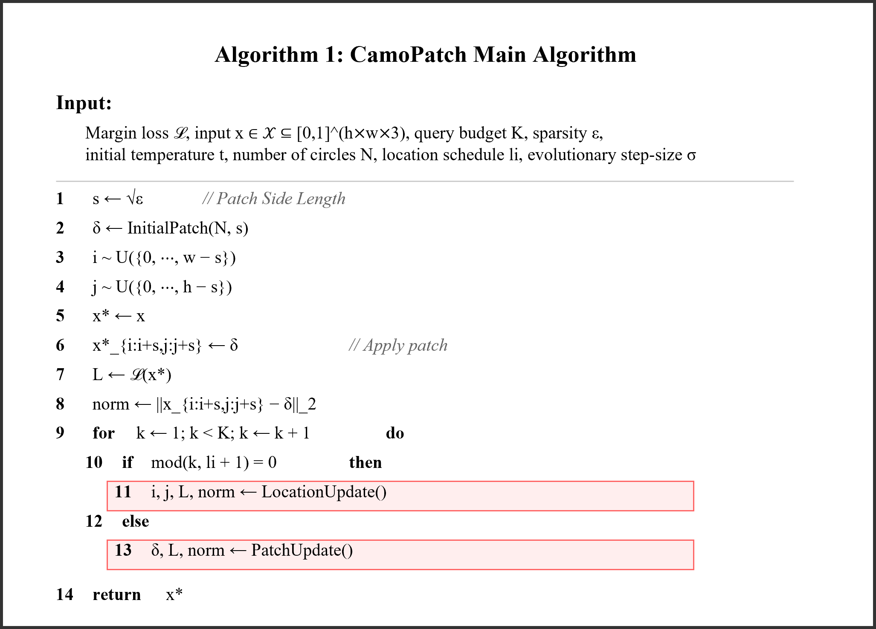
Method Overview
Squad 8

Slide 13
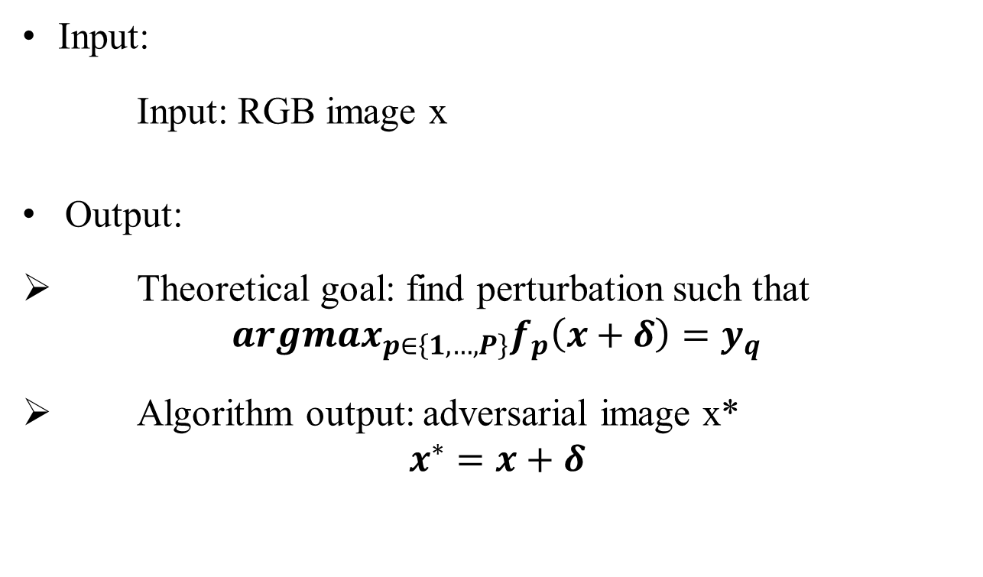
Problem Formulation
Input:
Input: RGB image x
Output:
Theoretical goal: find perturbation such that
$${argmax}_{p∈\left\{1,…,P\right\}}f_{p}\left(x+δ\right)=y_{q}$$
Algorithm output: adversarial image x*
$$x^{∗}=x+δ$$
Squad 8

Slide 14
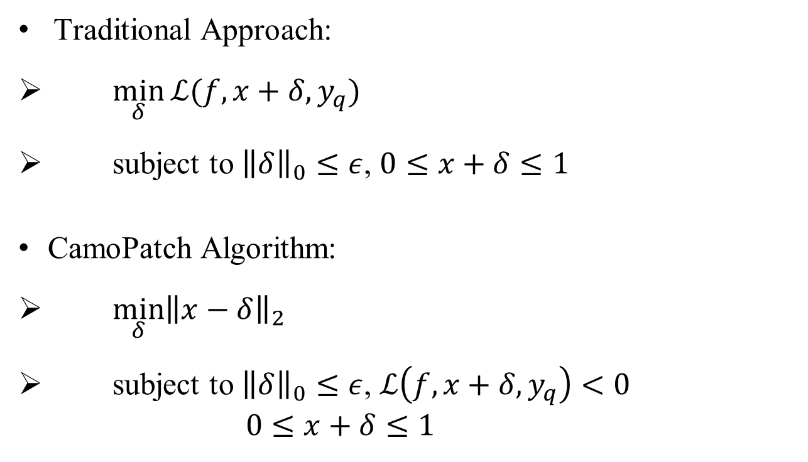
Problem Formulation
Traditional Approach:
$\min_{δ}{ℒ(f,x+δ,y_{q})}$
subject to ${\left\|δ\right\|}_{0}≤ε$, $0≤x+δ≤1$
CamoPatch Algorithm:
$\min_{δ}{{\left\|x−δ\right\|}_{2}}$
subject to ${\left\|δ\right\|}_{0}≤ε$, $ℒ\left(f,x+δ,y_{q}\right)<0$
$0≤x+δ≤1$
Squad 8

Slide 15
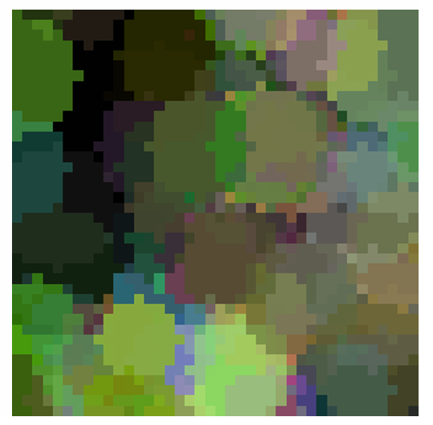
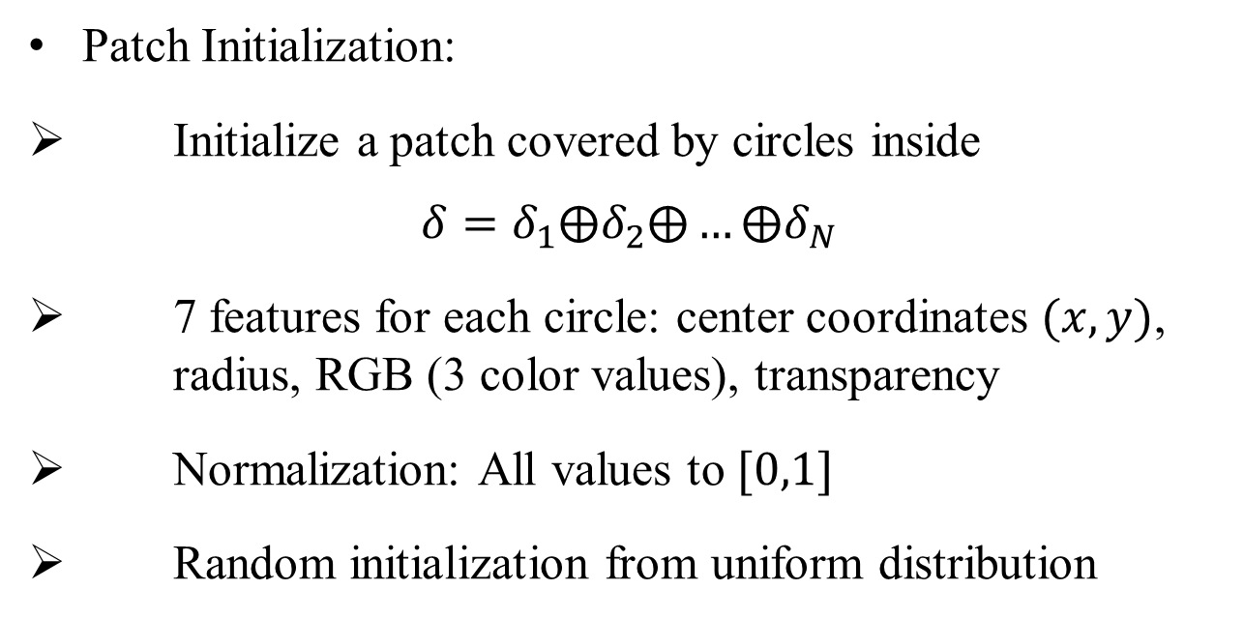
Patch Initialization and Optimization
Patch Initialization:
Initialize a patch covered by circles inside
$$δ=δ_{1}⨁δ_{2}⨁…⨁δ_{N}$$
7 features for each circle: center coordinates $(x,y)$, radius, RGB (3 color values), transparency
Normalization: All values to $[0,1]$
Random initialization from uniform distribution
Squad 8

Slide 16
Patch Initialization and Optimization
Patch Optimzation:
Method: ES(1+1) - Evolutionary Strategy
Update: sample from normal distribution
Solution selection: satisfies constraint and minimum l₂ distance
Squad 8

Slide 17
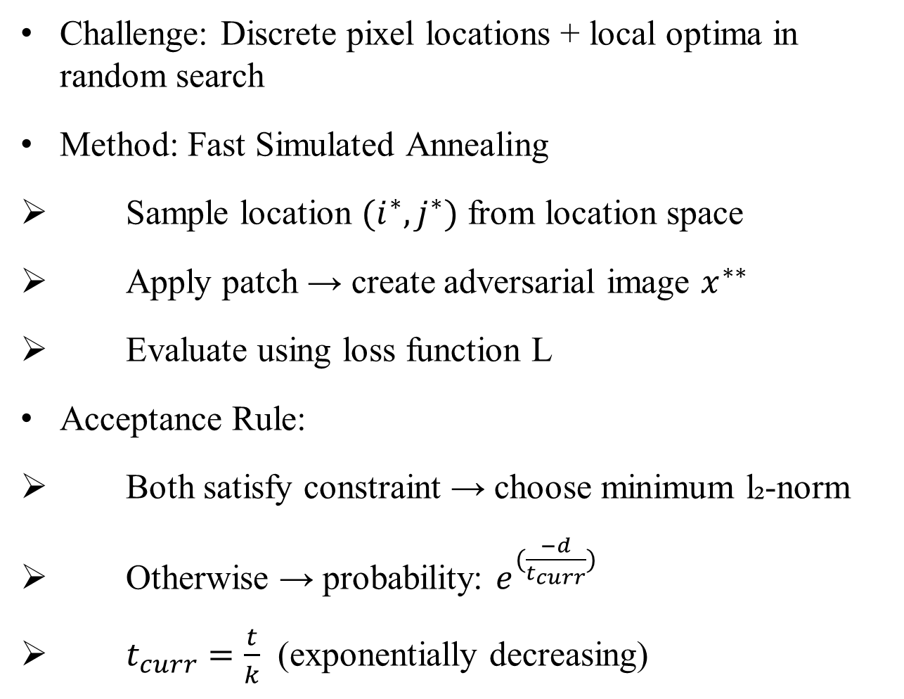
Location Optimization
Challenge: Discrete pixel locations + local optima in random search
Method: Fast Simulated Annealing
Sample location $(i^{∗},j^{∗})$ from location space
Apply patch → create adversarial image $x^{∗∗}$
Evaluate using loss function L
Acceptance Rule:
Both satisfy constraint → choose minimum l₂-norm
Otherwise → probability: $e^{(\frac{−d}{t_{curr}})}$
$t_{curr}=\frac{t}{k}$ (exponentially decreasing)
Squad 8

Slide 18
04
Experiment
Squad 8

